Slide 1
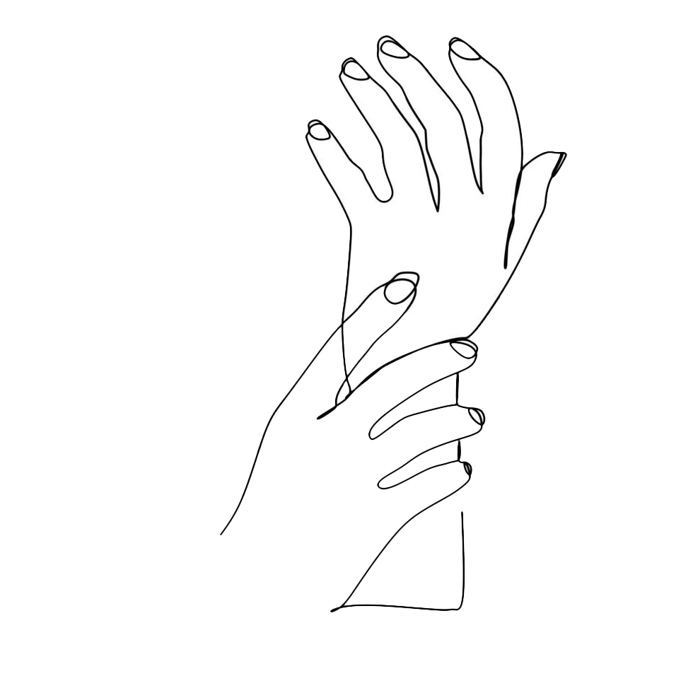
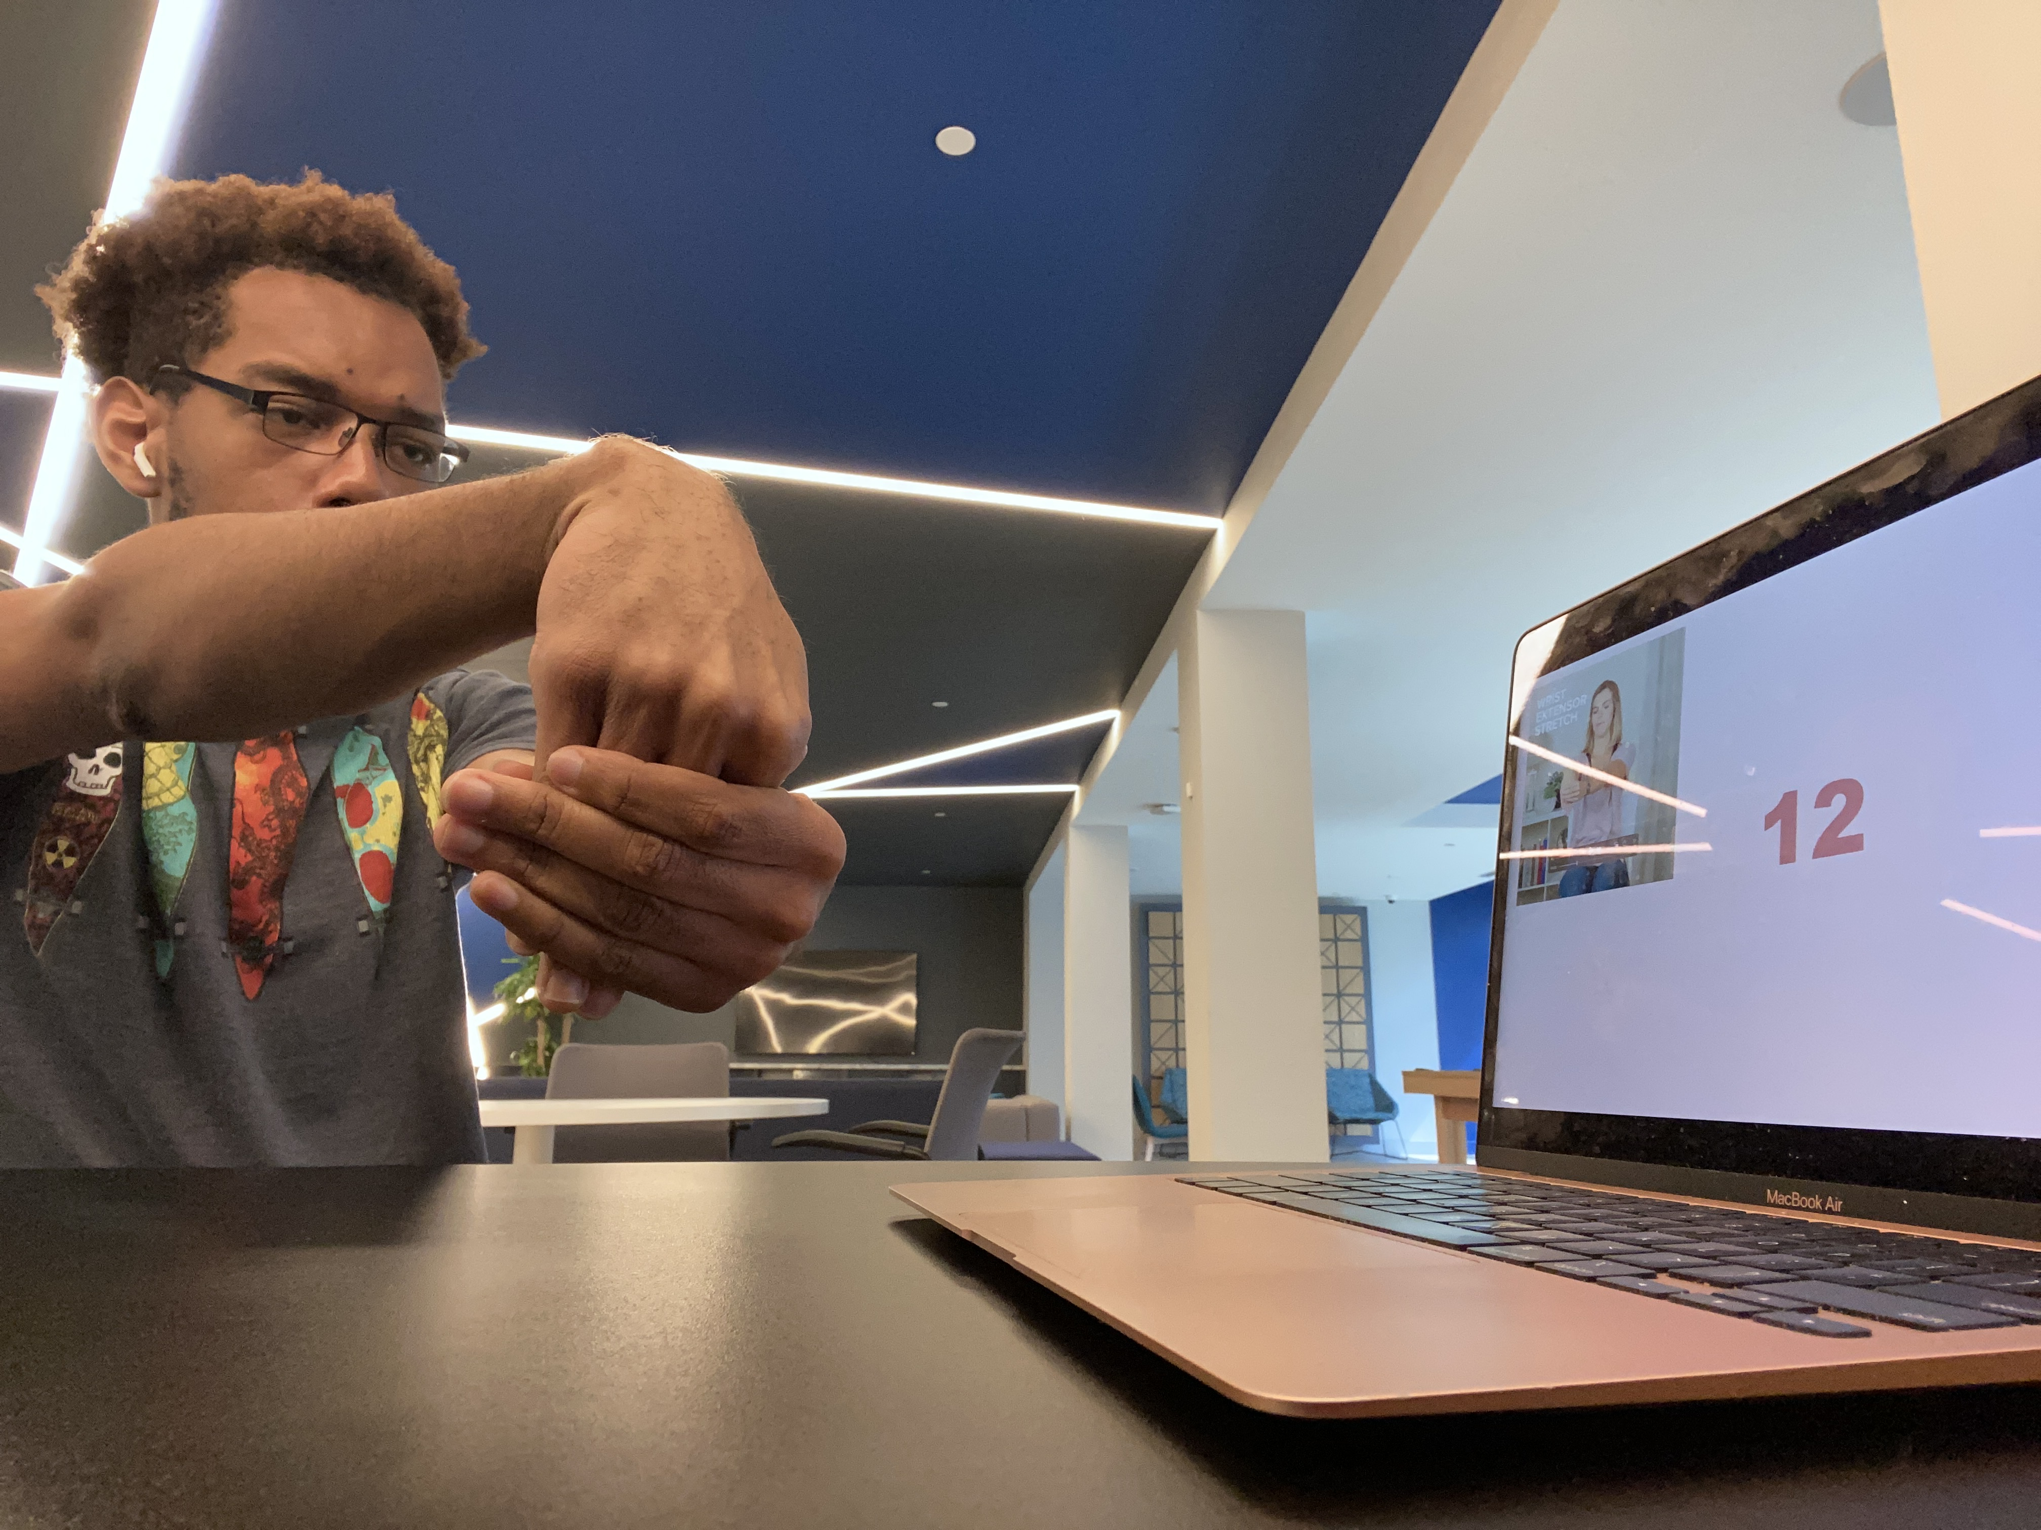



MyHandTracker
Schedule time throughout your day to stretch to prevent wrist damage
Created by Usif Aikhuele
function
audience
Data
Scheduled stretches
Video instruction
Timed exercises
Professors, teachers
Students
Writers, artists, white-collar workers
*3 to 6% of Americans have carpal tunnel
Caused by repetitive tasks, usually due to work or hobbies
If the right steps are taken early, it can be avoided
*LeBLANC, K. I. M. E. D. W. A. R. D., & Cestia, W. (2011, April 15). Carpal tunnel syndrome. American Family Physician. Retrieved April 30, 2023, from https://www.aafp.org/pubs/afp/issues/2011/0415/p952.html#:~:text=Carpal%20tunnel%20syndrome%20is%20the,adults%20in%20the%20general%20population.

